Slide 1
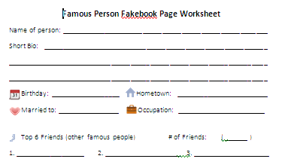
Fakebook Page Template
This template can be used to create a "fake" Facebook page for any famous person your students may be studying. Students will enjoy creating a page for an artist, an inventor, or a character in a book or movie (see the Hank Aaron example). Click on the Attachments Tab for a worksheet that can be used in conjunction with this activity (edit as you see fit). Please contact me if you have any questions. Enjoy!
Original Created by Amber Coggin and Modified by Brian Felker, Oconee Co. Schools

Slide 2
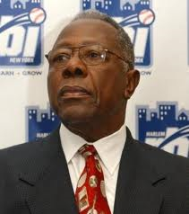
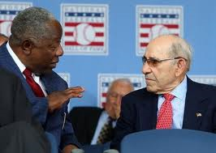
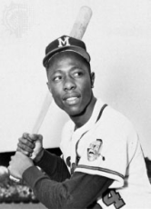
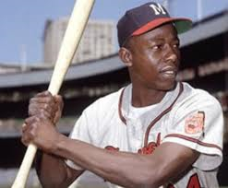
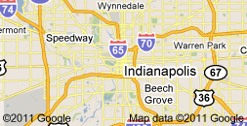
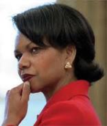
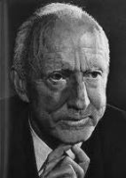
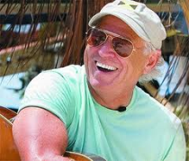
facebook
1
Search
Home Profile Account
Henry "Hank" Aaron
Edit Profile
Birthday
February 5, 1934
Share:
Status
Photo
Link
Video
Hometown
What's on your mind?
Mobile, AL
Welcome to my
Facebook page!
I enjoy playing
baseball, and I am
a member of the
Baseball Hall of
Fame.
Married to
Henry "Hank" Aaron
I just broke Babe Ruth's home run
record! The crowd went wild!
Billye Williams
Occupation
April 8, 1974
Like Comment
Major League Baseball Player
Henry "Hank" Aaron
checked in at
Friends
(490)
Wall
Indianapolis, IN
Info
Just signed with the
Indianapolis Clowns!
Photos
Friends
November 20, 1951
Like Comment Tag Friends

Slide 3
facebook
1
Search
Home Profile Account
Name
Edit Profile
Profile
Photo
Photo
Photo
Photo
Photo
Birthday
Share:
Status
Photo
Link
Video
Hometown
What's on your mind?
Bio
Profile
Photo
Name
Married to
Status
Occupation
Date
Like Comment
Name
checked in at
Friends (490)
Profile
Photo
Place
Map/picture of place
Status
Wall
Info
Date
Like Comment Tag Friends
Photos
Friends

Slide 4
facebook
1
Search
Home Profile Account
Edit Profile
Birthday
Share:
Status
Photo
Link
Video
Hometown
What's on your mind?
Married to
Occupation
Like Comment
checked in at
Friends
( )
Wall
Info
Photos
Friends
Like Comment Tag Friends

