Slide 1
Cell Structures, Functions and Transport

Slide 2
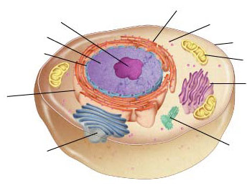
Figure 7-5 Plant and Animal Cells
Animal Cell
Section 7-2
Cytoplasm
Nucleolus
Nucleus
Cell Membrane
Go to Section:

Slide 3
Eukaryotic Cell Organelles and Function
Nucleus
Nickname: “The Control Center”
Function: holds the DNA
Parts:
Nucleolus: dark spot in the middle of the nucleus that helps make ribosomes

Slide 4
Figure 7-5 Plant and Animal Cells
Animal Cell
Section 7-2
Cytoplasm
Nucleolus
Ribosomes
Nucleus
Cell Membrane
Go to Section:

Slide 5
Eukaryotic Cell Organelles and Function
Ribosomes
Function: makes proteins
Found in all cells, prokaryotic and eukaryotic

Slide 6
Eukaryotic Cell Organelles and Function
Endoplasmic Reticulum (ER)
Nickname: “Roads”
Function: The internal delivery system of the cell

Slide 7
Figure 7-5 Plant and Animal Cells
Animal Cell
Section 7-2
Cytoplasm
Nucleolus
Ribosomes
Nucleus
Cell Membrane
Smooth Endoplasmic Reticulum
Rough Endoplasmic Reticulum
Go to Section:

Slide 8
Endoplasmic Reticulum
2 Types:
Rough ER:
Rough appearance because it has ribosomes
Function: helps make proteins, that’s why it has ribosomes
Smooth ER:
NO ribosomes
Function: makes fats or lipids

Slide 9
Figure 7-5 Plant and Animal Cells
Animal Cell
Section 7-2
Cytoplasm
Nucleolus
Ribosomes
Nucleus
Cell Membrane
Smooth Endoplasmic Reticulum
Rough Endoplasmic Reticulum
Golgi Complex
Go to Section:

Slide 10
Eukaryotic Cell Organelles and Function
Golgi Complex
Nickname: The shippers
Function: packages, modifies, and transports materials to different location inside/outside of the cell
Appearance: stack of pancakes

Slide 11
Figure 7-5 Plant and Animal Cells
Animal Cell
Section 7-2
Cytoplasm
Nucleolus
Ribosomes
Nucleus
Cell Membrane
Smooth Endoplasmic Reticulum
Rough Endoplasmic Reticulum
Golgi Bodies
Go to Section:

Slide 12
Eukaryotic Cell Organelles and Function
Lysosomes: circular, but bigger than ribosomes)
Nickname: “Clean-up Crews”
Function: to break down food into particles the rest of the cell can use and to destroy old cells

Slide 13
Figure 7-5 Plant and Animal Cells
Animal Cell
Section 7-2
Cytoplasm
Nucleolus
Ribosomes
Nucleus
Cell Membrane
Mitochondria
Rough Endoplasmic Reticulum
Smooth Endoplasmic Reticulum
Golgi Bodies

Slide 14
Eukaryotic Cell Organelles and Function
Mitochondria
Nickname: “The Powerhouse”
Function: Energy formation
Breaks down food to make ATP
ATP: is the major fuel for all cell activities that require energy

Slide 15
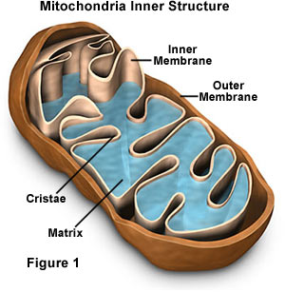

Slide 16
Animal Cell
Cytoplasm
Nucleolus
Ribosomes
Nucleus
Cell Membrane
Mitochondria
Rough Endoplasmic Reticulum
Smooth Endoplasmic Reticulum
Golgi Bodies

Slide 17
Now let’s talk about structures only found in PLANT Cells!!

Slide 18
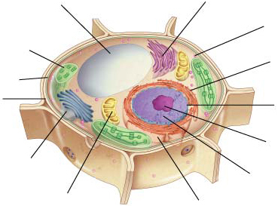
Figure 7-5 Plant and Animal Cells
Plant Cell
Section 7-2
Vacuole
Cell Membrane
Go to Section:

Slide 19
Eukaryotic Cell Organelles and Function
Vacuoles
Function: stores water
This is what makes lettuce crisp
When there is no water, the plant wilts

Slide 20
Figure 7-5 Plant and Animal Cells
Plant Cell
Section 7-2
Vacuole
Chloroplasts
Cell Membrane
Go to Section:

Slide 21
Eukaryotic Cell Organelles and Function
Chloroplasts
Function: traps energy from the sun to produce food for the plant cell
Green in color because of chlorophyll, which is a green pigment

Slide 22
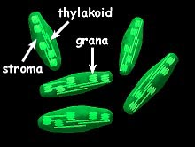
Chloroplasts

Slide 23
Figure 7-5 Plant and Animal Cells
Plant Cell
Section 7-2
Vacuole
Chloroplasts
Cell Membrane
Cell Wall
Go to Section:

Slide 24
Eukaryotic Cell Organelles and Function
Cell Wall
Function: provides support and protection to the cell membrane
Found outside the cell membrane in plant cells

Slide 25
Plant Cell
Cytoplasm
Vacuole
Smooth ER
Ribosomes
Chloroplasts
Cell Membrane
Cell Wall
Nucleolus
Golgi Bodies
Nucleus
Mitochondria
Rough ER

Slide 26
Comparing Plant and Animal Cells
Plant
Animal

